Slide 1

Software Solutions
Programs That Let You Work and Play

Slide 2
Lesson Outline
Familiarise different kinds of application software
Compare application software and system software
Differences between commercial software and open-source software and describe models for software distribution.
Considerations around the decision to upgrade your software.
Uses and features of digital multimedia software
Types of software that large and small businesses use

Slide 3
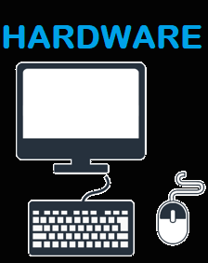
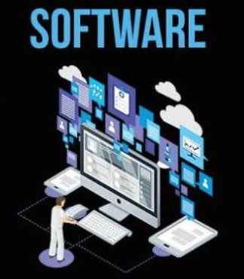
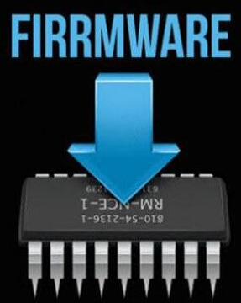
Software v Hardware v Firmware
Software: A set of instructions that tells the computer what to do and how to perform a task
Hardware: Physical elements of a computer or an electronic system
Firmware: Computer software permanently placed to provide low-level control for a device’s specific hardware

Slide 4
Software Basics Application vs. System Software Vs. Utility software
Three basic types of software
Application software
System software
Utility software
Notes:
Software refers to instructions that tell the computer what to do.
Your computer has two basic types of software:
Application software is used to do tasks at home, school, and work.
System software helps run the computer and coordinate instructions between application software and the computer’s hardware devices.

Slide 5
Software Basics Distributing Software
Ways software is created
Proprietary (Commercial)
Open-source (free)
Ways to distribute software
Local installation
Software as a Service (SaaS)
Subscription, fee for certain period of time, then it is free, for example, Adobe Creative Cloud
Notes:
There are two ways software is created:
Proprietary (commercial) software is created by companies for profit and then sold to you.
Open source software is software that is available free of charge and with few licensing and copyright restrictions.
There are various ways to distribute software:
Local installation
Software as a Service (SaaS)
Subscription

Slide 6
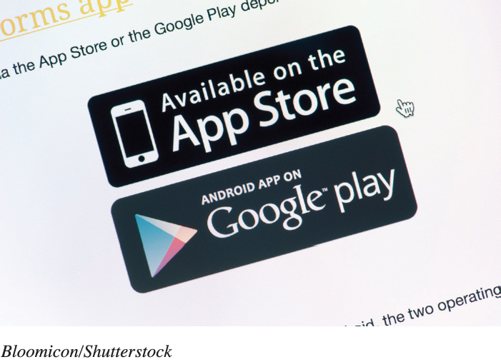
Managing Your Software Purchasing Software
DVD from brick-and-mortar store or through online websites
Downloading from the Internet (as purchase or subscription)
Student discounts
Freeware
Preinstalled with computer
Beta version
Notes:
Normally software can be acquired through a brick-and-mortar store or by downloading it from the Internet.
Students can often find discounted software.
Freeware is software that you do not have to pay for.
A Beta version is a trial version used to help the company debug its software.

Slide 7

Managing Your Software Installing and Uninstalling Software
System requirements
Restore point
Full installation
Custom installation
Recovering from a computer crash
Uninstalling Software
Recovery drive
Notes:
Every program has a set of system requirements that specify the minimum recommended standards.
It is good to set a restore point before installing new software.
A full installation copies all the most commonly used files to your hard drive.
In custom installation, you decide which features you want installed.
Uninstalling software removes it from your hard drive.
Creating a Recovery drive helps to recover from a computer crash.

Slide 8
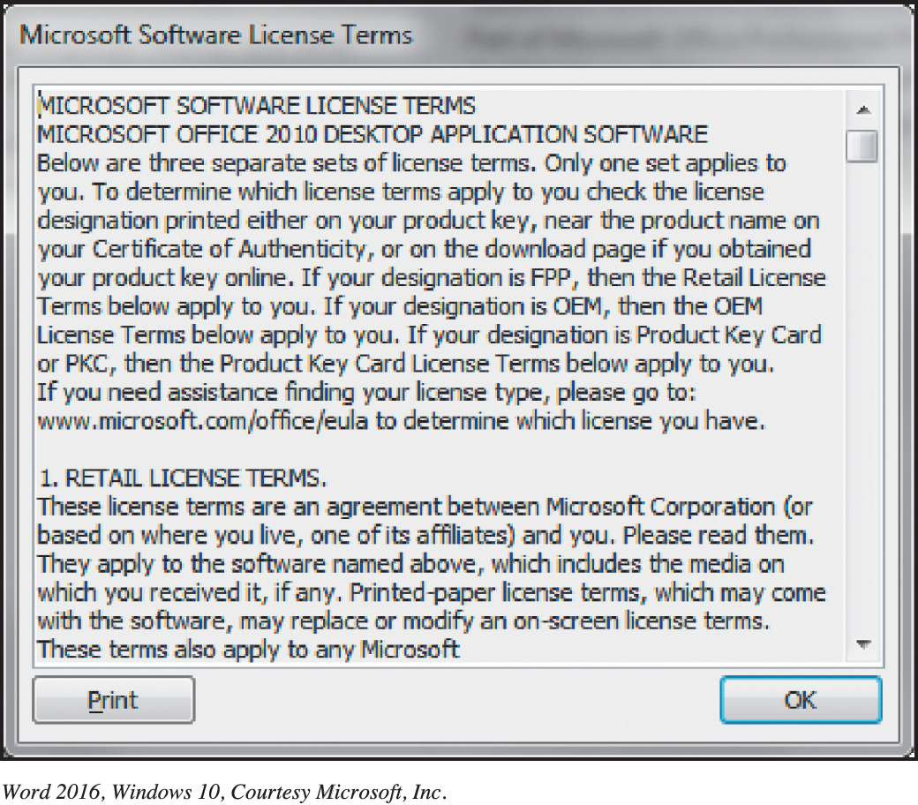
Managing Your Software Software Licenses
End User License Agreement (EULA)
States the following:
Ultimate owner
Copies allowed
# of installations allowed
Warranties
Copyleft
Notes:
A software license, also known as an End User License Agreement, is an agreement between you, the user, and the software company.
Generally, the agreement states who the ultimate owner of the software is, under what circumstances copies of the software can be made, and whether the software can be installed on any other machine. Finally, the license agreement will state what, if any, warranty comes with the software.
This concept of redistributing modified open source software under the same terms as the original software is known as copyleft.

Slide 9
Managing Your Software Upgrading Software
Not needed when subscriptions or SaaS applicable
Is it cost effective?
Verify backwards compatibility
Always update security patches and fixes
Notes:
Upgrades and updates are not required if you have a subscription to the software or are using software as a service.
There’s no need to rush out and buy the latest version of a software program every time one is available.
Vendors make new versions backward compatible, meaning that the new versions can recognize (open) files created with older versions.

Slide 10
Productivity and Business Software Productivity Software
Allows you perform various tasks required at home, school, and business
Proprietary (Microsoft Office and Apple iWork)
Installed: Open Source (LibreOffice)
Web-Based (Microsoft Office Online, Google Docs, Zoho, and ThinkFree
Word processing software
Electronic Spreadsheets
Database Systems
Presentation Software
Note taking Software
Personal Information Manager Software
Small business software
Accounting software
Desktop publishing (DTP) software
Web authoring software

Slide 11

Productivity and Business Software Business Software
Software for Larger and Specialised Businesses
Vertical market software is designed for a specific industry
Computer-aided design (CAD) creates automated designs, technical drawings, and 3D model visualizations
Home or landscape planning
SketchUp Make
Notes:
Vertical market software is designed for a specific industry.
Computer-aided design (CAD) create automated designs, technical drawings, and 3D model visualizations.
Home or landscape planning can be used in designing home improvements.
SketchUp Make is an example of this type of software.

Slide 12
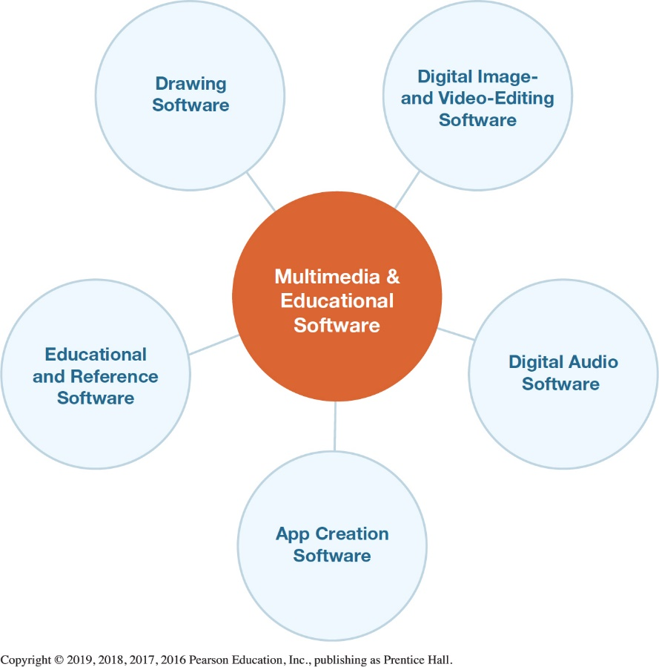
Multimedia and Educational Software Digital Multimedia Software)
Multimedia software
Required to produce computer games, animations, and movies
Photo and image editing software used to edit photos
Digital video-editing software used to refine videos
Notes:
Multimedia software is required to produce computer games, animations, and movies.
Photo and image editing software are used to edit photos.
Digital video-editing software is used to refine videos.

Slide 13
Multimedia and Educational Software Educational and Reference Software
Educational and Reference Software: A Sample
Test Preparation
Simulation
Instructional
Trip Planning
Home design/Improvement
Course Management
Brain Training
Genealogy
Notes:
Educational and Reference Software: A Sample
Test Preparation
Simulation
Instructional
Trip Planning
Home design/Improvement
Course Management
Brain Training
Genealogy

Slide 14


Questions

Slide 15
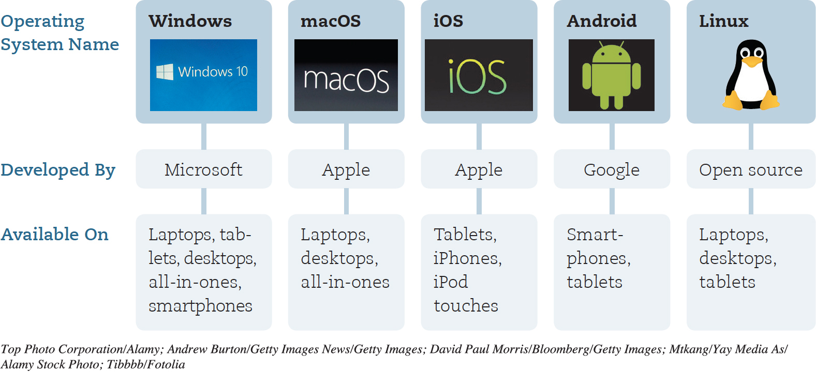
Operating System Fundamentals Operating System types
Notes:
Figure 5.1 lists a number of common operating systems.

Slide 16
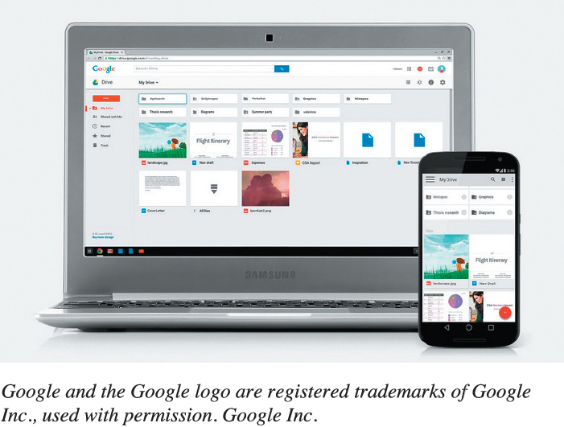
Understanding System Software Operating Systems for Personal Use
Top three for personal computers
Windows
macOS
Linux
Mobile OS
Android
iOS
Windows
Web-based
Google Chrome OS
Notes:
The top three operating systems for personal computers are:
Microsoft Windows
Apple’s macOS
Linux
Personal devices require special operating systems as well. These include:
Android
iOS
Microsoft Windows
Google Chrome OS (see Figure 5.2), is a web-based OS. With the Chrome OS, virtually no files are installed on your computing device. Rather, the main functionality of the OS is provided through a web browser.

Slide 17
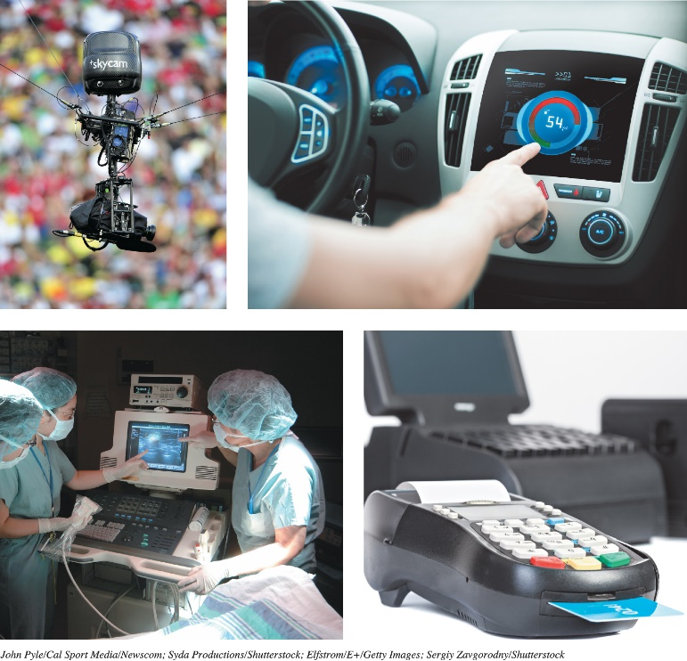
Understanding System Software Operating Systems for Machinery, Networks, and Business
Real-Time OS (RTOS)
Machine that performs repetitive series of specific tasks in precise time
Extensive use in Robotics
Multiuser Operating System
Known as network OS
Allows multiple users access
to the computer at the same time
Example - Unix
Notes:
Specialized operating systems are needed for machinery, networks, and business.
Machinery that performs a repetitive series of specific tasks in an exact amount of time requires a real-time operating system (RTOS).
Multiuser operating systems allow multiple users access to the computer at the same time.
UNIX is a multiuser, multitasking OS that is used as a network OS.

Slide 18
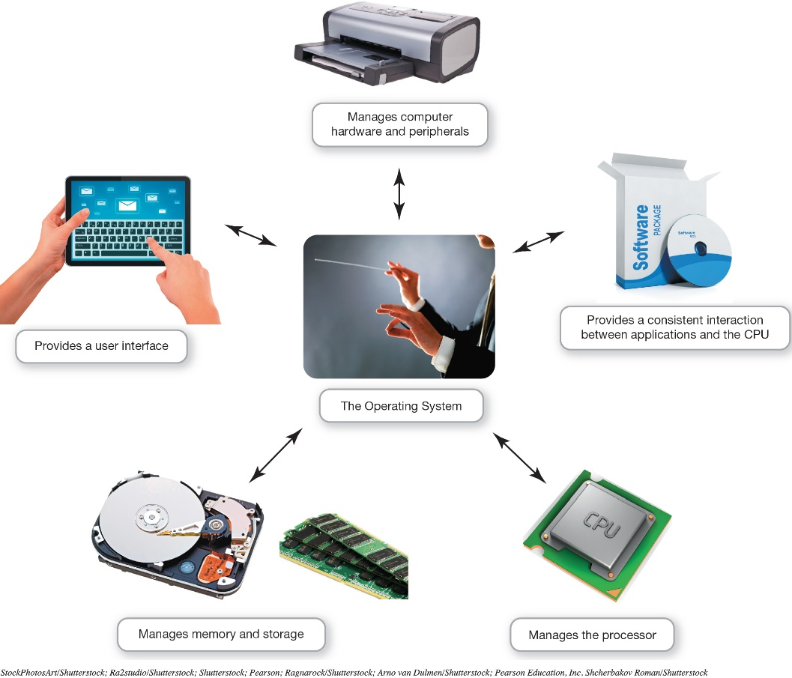
What the Operating System Does? The User Interface
OS—Coordinates and directs the flow of data and information
Enables user to interact with the computer
Types of interfaces
Command-driven interface (CLI)
Menu-driven interface
Graphical user interface (GUI)
Notes:
The operating system is like an orchestra's conductor. It coordinates and directs the flow of data and information through the computer system.

Slide 19
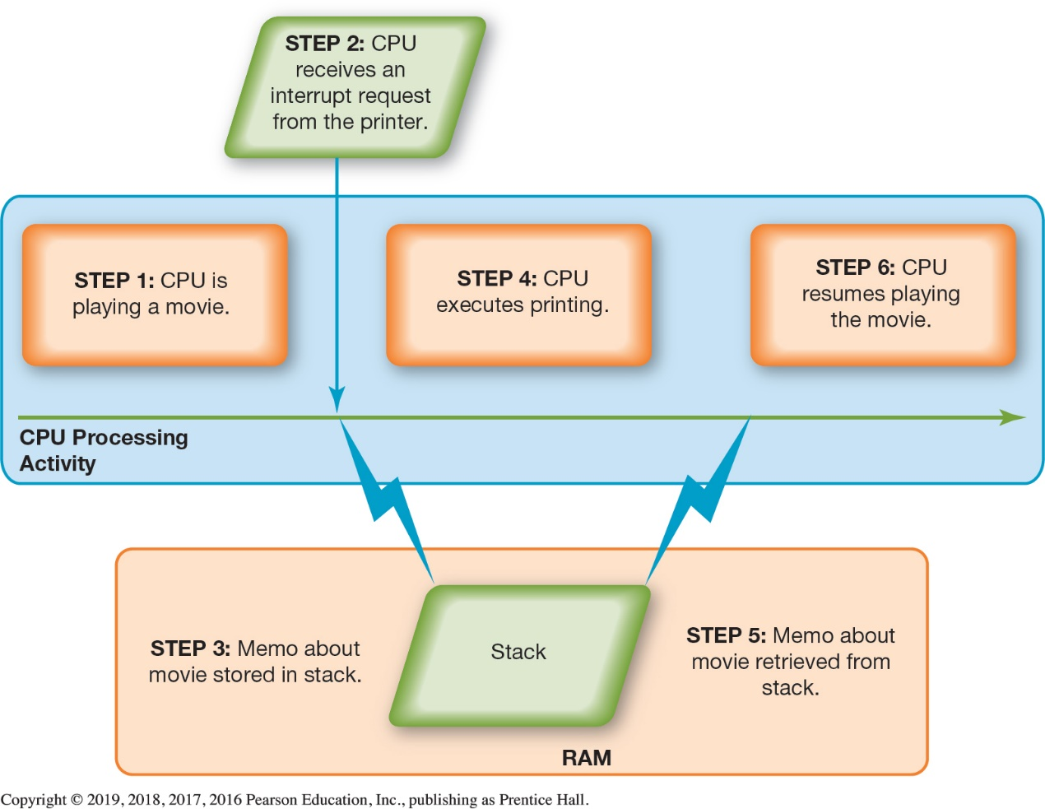
What the Operating System Does? Hardware Coordination
Event handler
Interrupt handler
Hardware Interrupts are generated by hardware devices to signal that they need some attention from the OS.
Software Interrupts are generated by programs when they want to request a system call to be performed by the operating system.
Traps are generated by the CPU itself to indicate that some error or condition occurred for which assistance from the operating system is needed.
Preemptive multitasking – Priorities in an interrupt table
Spooler
Notes:
Every keystroke, every mouse click (or touch on the screen), and each signal to the printer and from the Blu-ray drive creates an action, or event, in the respective device to which the OS responds.
Every device has its own type of interrupt, which is associated with an interrupt handler, a special numerical code that prioritizes the requests.
Hardware Interupts are generated by hardware devices to signal that they need some attention from the OS. They may have just received some data (e.g., keystrokes on the keyboard or an data on the ethernet card); or they have just completed a task which the operating system previous requested, such as transfering data between the hard drive and memory.
Software Interupts are generated by programs when they want to request a system call to be performed by the operating system.
Traps are generated by the CPU itself to indicate that some error or condition occured for which assistance from the operating system is needed.
These requests are placed in the interrupt table in the computer’s primary memory (RAM). The OS processes the task assigned a higher priority before processing a task assigned a lower priority. This is called preemptive multitasking.
The spooler is a program that helps coordinate all print jobs currently being sent to the printer.

Slide 20
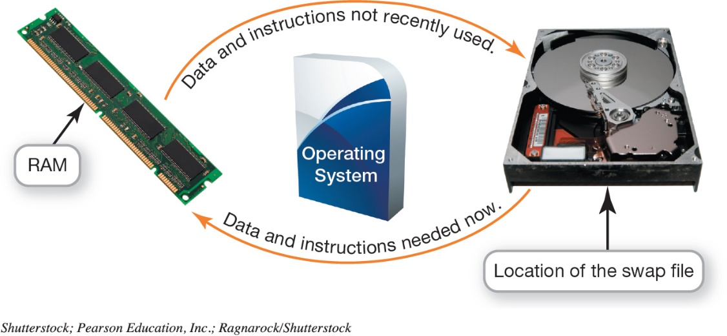
What the Operating System Does? Hardware Coordination
Memory and Storage Management
RAM—limited capacity
Borrowing drive space is called virtual memory
Increase RAM to avoid using virtual memory
Swap file
Paging - The process of swapping
Thrashing - Excessive paging
Notes:
RAM has limited capacity.
When there isn’t enough room in RAM, it borrows room from the hard drive.
Borrowing hard drive space is called virtual memory.
When more RAM is needed, the OS swaps out from RAM the data or instructions that haven't been used recently and moves them to a temporary storage area on the hard drive.
Increasing the amount of RAM helps the computer to avoid having to send data and instructions to virtual memory.
The process of swapping is known as paging.
Excessive paging is called thrashing.

Slide 21
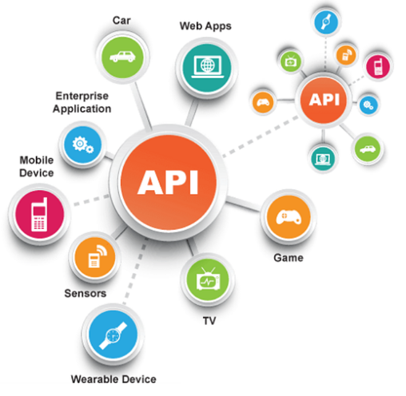
What the Operating System Does? Software Application Coordination
Application Programming Interface (API)
Blocks of code the CPU recognizes
Used for similar procedures
Example: Microsoft Direct X
Notes:
Every computer program, no matter what its type or manufacturer, needs to interact with the CPU using computer code.
Rather than having the same blocks of code for similar procedures in each program, the OS includes the blocks of code, called Application Programming Interface.
Microsoft DirectX, for example, is a group of multimedia APIs built into the Windows OS that improves graphics and sounds.

Slide 22

Starting Your Computer - The Boot Process
Step 1
Activating BIOS
Manages the exchange of data between the OS and the input and output devices
BIOS is also responsible for loading the OS into RAM
Step 2
Performing the Power-On Self-Test
Ensures that essential peripheral devices are attached and operational
Step 3
Loading the OS
System files loaded into RAM
Kernel, essential component of the OS, is then loaded
Step 4
Checking Further Configurations and Customizations
Registry contains configurations used by the OS and applications
Notes:
The boot process consists of four basic steps:
Step 1: Activating BIOS
This manages the exchange of data between the OS and the input and output devices.
The BIOS is also responsible for loading the OS into RAM.
Step 2: Performing the Power-On Self-Test
This ensures that essential peripheral devices are attached and operational.
The boot process consists of four basic steps: (cont)
Step 3: Loading the OS
System files are loaded into RAM.
The kernel, the essential component of the OS, is then loaded.
Step 4: Checking Further Configurations and Customizations
The registry contains configurations used by the OS and applications.

Slide 23
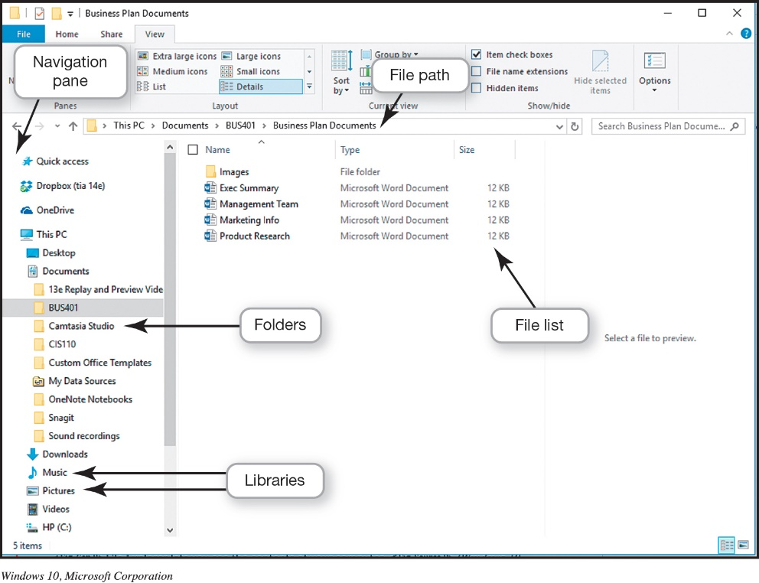
File Management Organizing Your Files
Directory
Hierarchical structure of the computer’s contents
Drives
Libraries
Folders
Subfolders
Files
Root directory
Top of the filing structure
File allocation table (FAT)
Table that an operating system maintains on a hard disk that provides a map of the clusters (the basic units of logical storage on a hard disk) that a file has been stored in
Notes:
An additional function of the OS is to enable file management, which provides an organizational structure to the computer’s contents.
Windows organizes your computer in a hierarchical directory structure composed of drives, libraries, folders, subfolders, and files.
The C: drive is like a large filing cabinet in which all files are stored. The C: drive is the top of the filing structure of your computer, referred to as the root directory.

Slide 24



Understanding System Software Operating Systems for Personal Use
Linux was first released on September 17, 1991, by Linus Torvalds
Open-source Linux source code is freely available
it is community-based development project
Linux is the Most Secure OS because of it is Highly Configurable mode
Linux kernel and application programs supports their installation on any kind of hardware platform.
Notes:
Linux is an open source OS designed for use on personal computers and web servers.
Linux is available for download in various packages known as distributions or distros.
The combination of an OS and a specific processor is referred to as a computer’s platform.
The decision to update to the newest features of your OS depends on which OS you’re using.

Slide 25
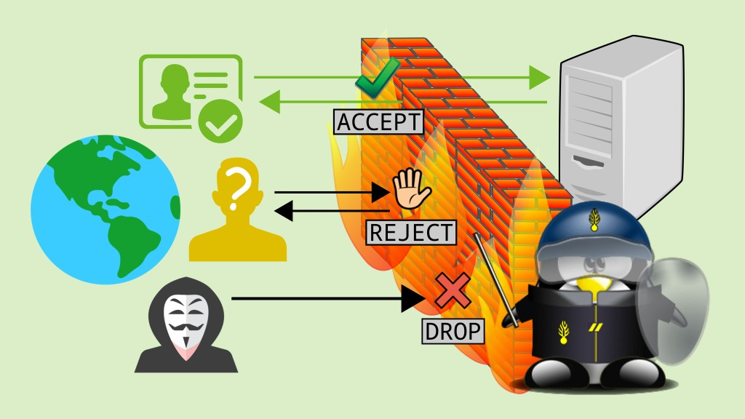
Utility Programs
Incorporated into the operating system
Firewall and file-compression utilities
Standalone utility programs
Antivirus and security programs
Freeware
Notes:
Utility programs are small applications that perform special functions and come in three flavors:
Those that are included with the OS.
Those sold as standalone programs.
Those offered as freeware—anti-malware software like Ad-Aware from Lavasoft.
In general, the basic utilities designed to manage and tune the computer hardware are incorporated into the operating system.
The standalone utility programs typically offer more features or an easier user interface for backup, security, diagnostic, or recovery functions.

Slide 26
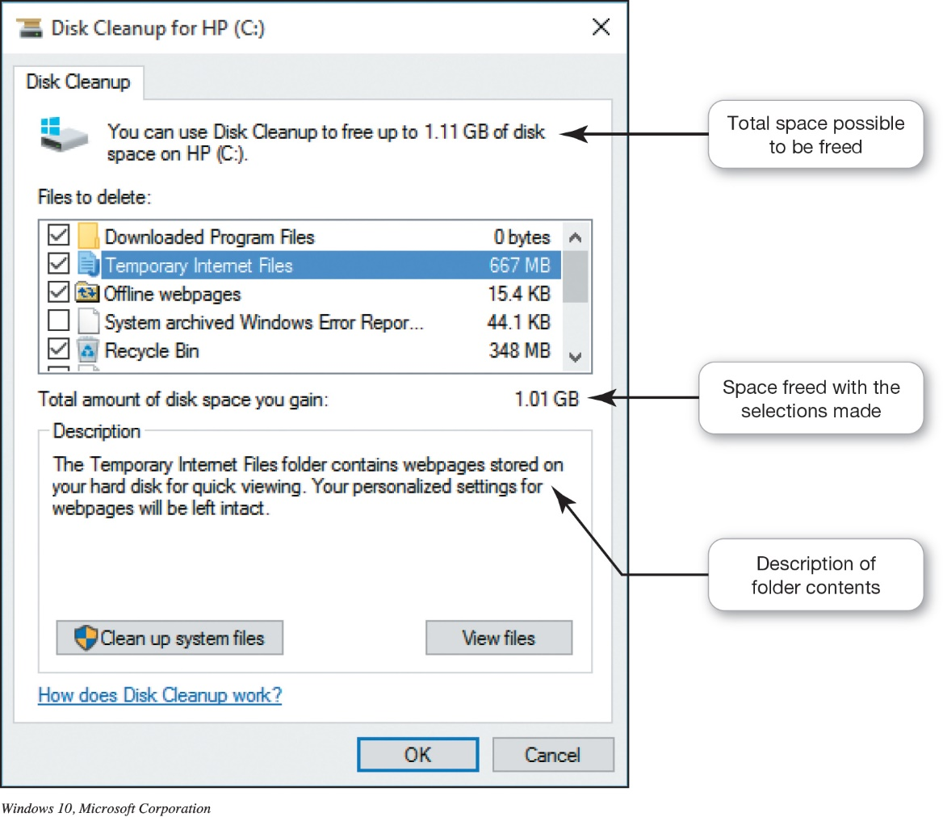
Utility Programs Windows Administrative Utilities
System Performance Utilities
Disk Cleanup
Task Manager
Disk Defragmenter
Notes:
Disk cleanup removes unnecessary files from your hard drive.
Sometimes the system becomes confused, leaving references on the file allocation table or FAT to files that no longer exist or have been moved.
If a program has stopped working, you can use the Windows Task Manager utility to check on the program or to exit the nonresponsive program.
Disk defragmentation rearranges fragmented data so that related file pieces are unified.

Slide 27
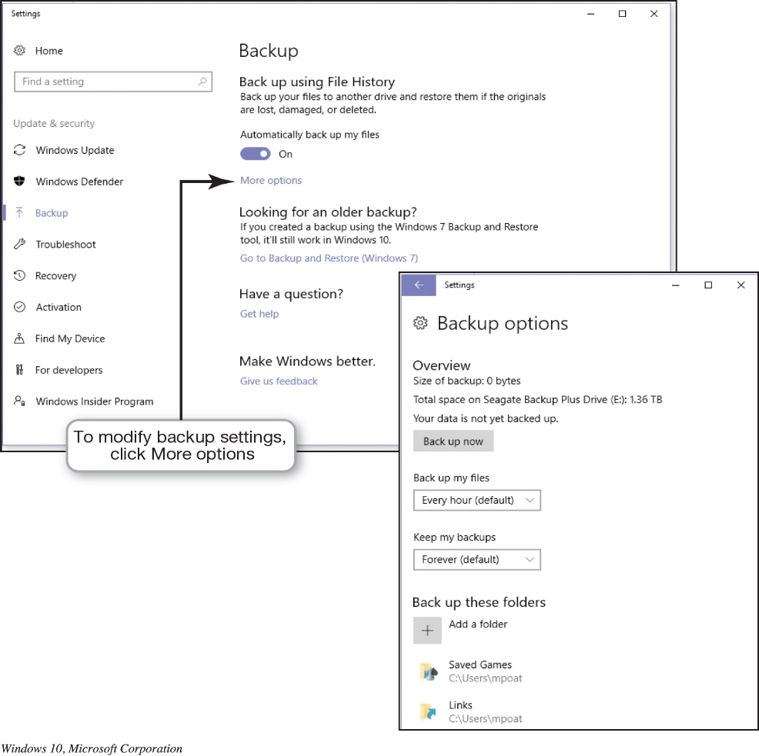
Utility Programs Windows Administrative Utilities
File and System Backup Utilities
File History
System Restore
Notes:
When you use the File History utility, you can have Windows automatically create a duplicate of your libraries, desktop, contacts, and favorites and copy it to another storage device.
Windows has a utility called System Restore that lets you roll your system settings back to a specific date when everything was working properly.

Slide 28
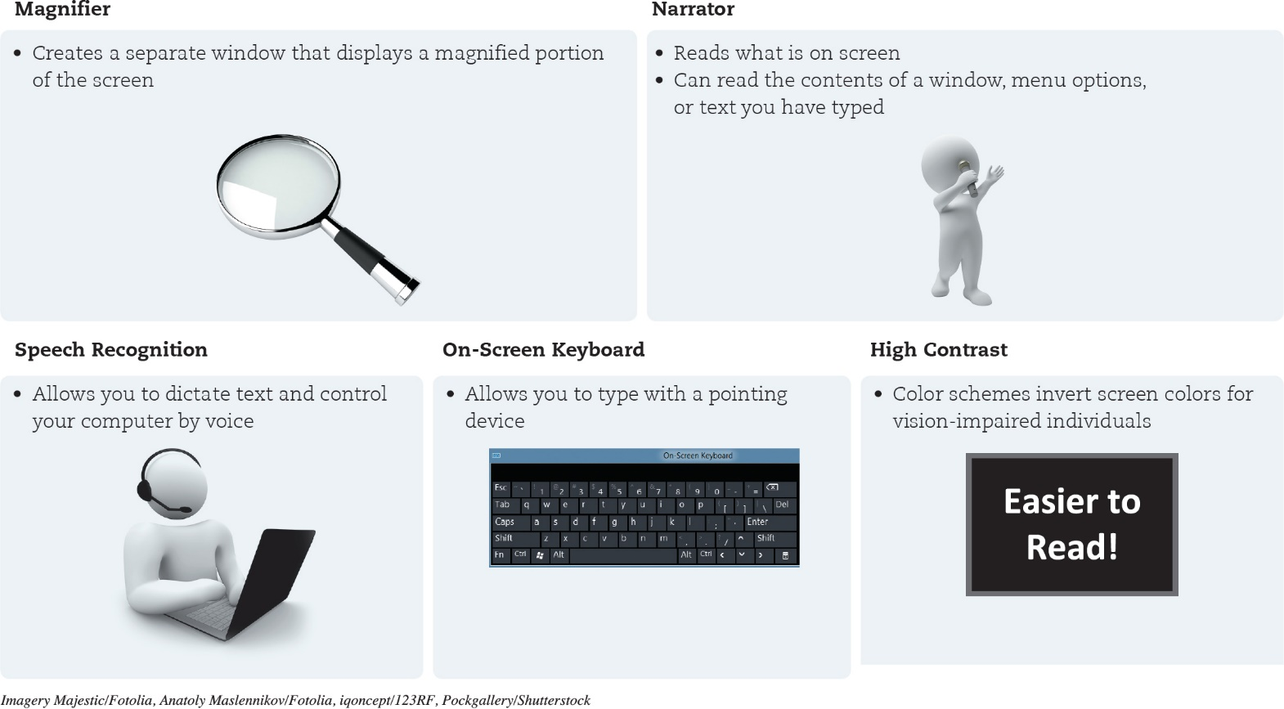
Utility Programs Windows Administrative Utilities
Accessibility Utilities
Designed for users with special needs
Notes:
Microsoft Windows includes an Ease of Access Center, which is a centralized location for assistive technology and tools to adjust accessibility settings.
In the Ease of Access Center, you can find tools to help users with disabilities. If you’re not sure where to start or what settings might help, a questionnaire asks you about routine tasks and provides a personalized recommendation for settings that will allow you to better use your computer.

Slide 29
Questions

